Slide 1

Vel Tech Rangarajan Dr. Sagunthala R&D Institute of Science and Technology
School of Computing
Department of Computer Science and Engineering
10211CS224 / FULL STACK APPLICATION DEVELOPMENT (JAVA)
PROJECT REVIEW : MILESTONE PROJECT – 1
Date: 23-03-2026
Subscription-Based Membership Engine with Tiered Logic
SDG: SDG 9 – Industry, Innovation and Infrastructure
Presented By:
K.SAI MANIKANTA– VTU25937 – 23UECS0639
Courses Handling Faculty:
Dr. S . HEMAMALINI - M.E.,Ph.D.,

Slide 2
INTRODUCTION
A Subscription-Based Membership Engine is a system that manages users and their membership plans efficiently. Many organizations offer different subscription levels such as Free, Pro, and Premium. Managing these subscriptions manually can lead to errors and inefficiency. This project provides an automated web-based platform to manage membership registrations, subscription plans, and payments. The system allows administrators to monitor members and their plans easily. It improves data accuracy and simplifies membership management. The system is designed using modern full-stack development technologies.
1
2
3
4
5
6
7
8
9

Slide 3

PROBLEM STATEMENT
In many organizations, membership management is still handled manually or using basic systems. This causes difficulties in tracking members, subscription plans, and payment details. Manual processes may lead to data errors, delays, and inefficient management. There is a need for a reliable and automated system that can manage memberships effectively. The system should allow easy registration, subscription selection, and data management. Therefore, developing a web-based membership engine can improve efficiency, accuracy, and overall user experience.
1
2
3
4
5
6
7
8
9

Slide 4
OBJECTIVE(S)
1 To design and develop a web-based subscription membership management system.
2 To implement tier-based membership logic (Free, Pro, Premium) for better subscription control.
1
2
3
4
5
6
7
8
9

Slide 5
PROPOSED SYSTEM
• The proposed system provides a web-based platform for membership management. • Users can register and choose their subscription plan. • The system supports multiple membership tiers such as Basic, Silver, and Gold. • Admin can manage members, update plans, and delete memberships. • The system stores data securely in a database. • It provides a simple and interactive user interface. • The system reduces manual effort and increases efficiency. • It improves accuracy in managing subscription details.
1
2
3
4
5
6
7
8
9

Slide 6
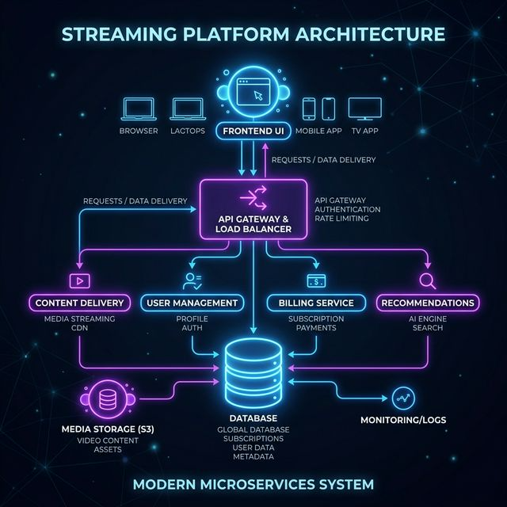
PROPOSED SYSTEM ARCHITECTURE
admin123
1
2
3
4
5
6
7
8
9

Slide 7
TECHNOLOGIES USED
Frontend: HTML, CSS, Thymeleaf
Backend: Nodejs
Database: MYSQL
Tools: VS code
Hardware/Software Requirements:
Hardware • Computer / Laptop • Minimum 4GB RAM
Software • Java JDK • Eclipse IDE • Spring Boot • Web Browser
1
2
3
4
5
6
7
8
9

Slide 8
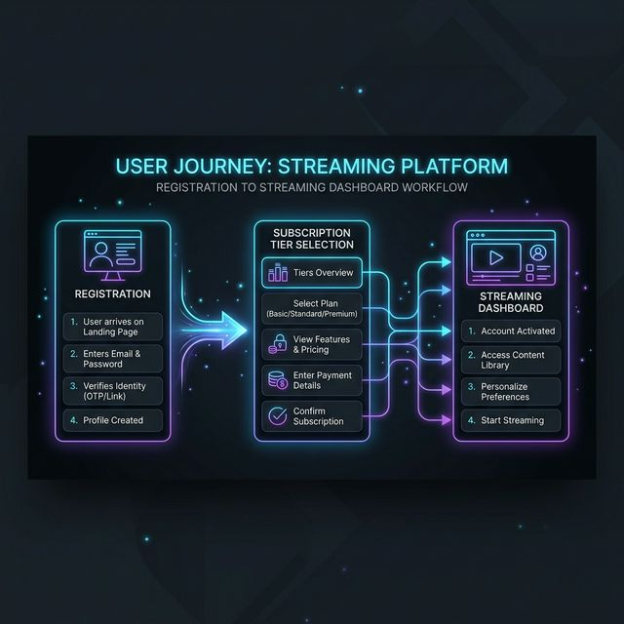
WORKFLOW
1
2
3
4
5
6
7
8
9

Slide 9
MODULE DESCRIPTION
Module 1: User Management Handles member registration and membership plan selection.
Module 2: Membership Processing Implements the logic for different membership tiers.
Module 3: Database Management Stores and retrieves membership information securely.
Module 4: Dashboard & Reporting Displays member details and subscription information for administrators.
1
2
3
4
5
6
7
8
9

Slide 10
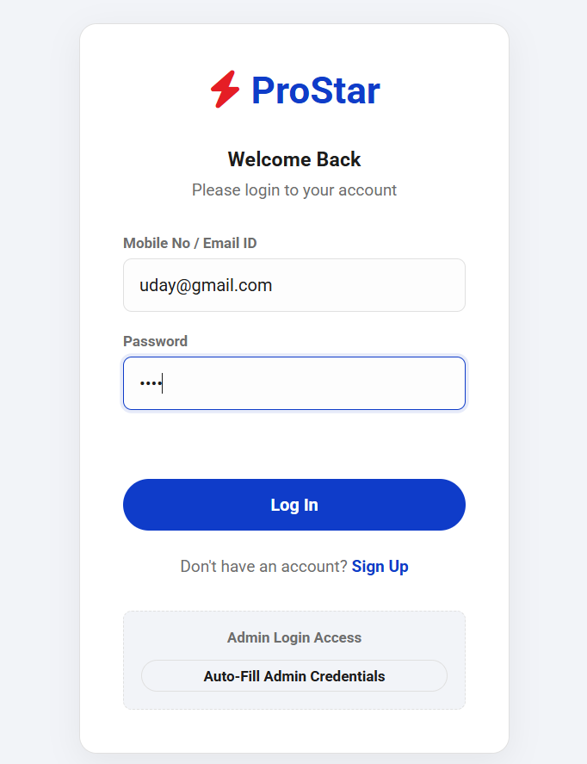
IMPLEMENTATION SCREENSHOTS
1
2
3
4
5
6
7
8
9

Slide 11
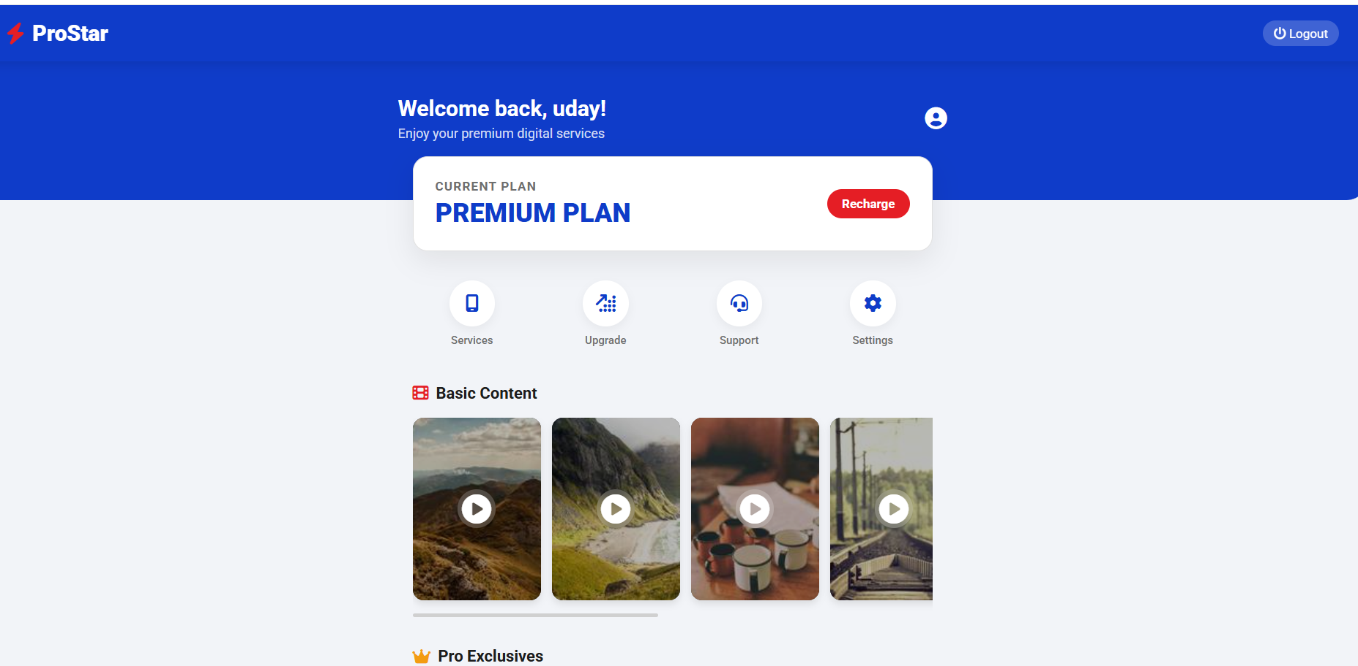
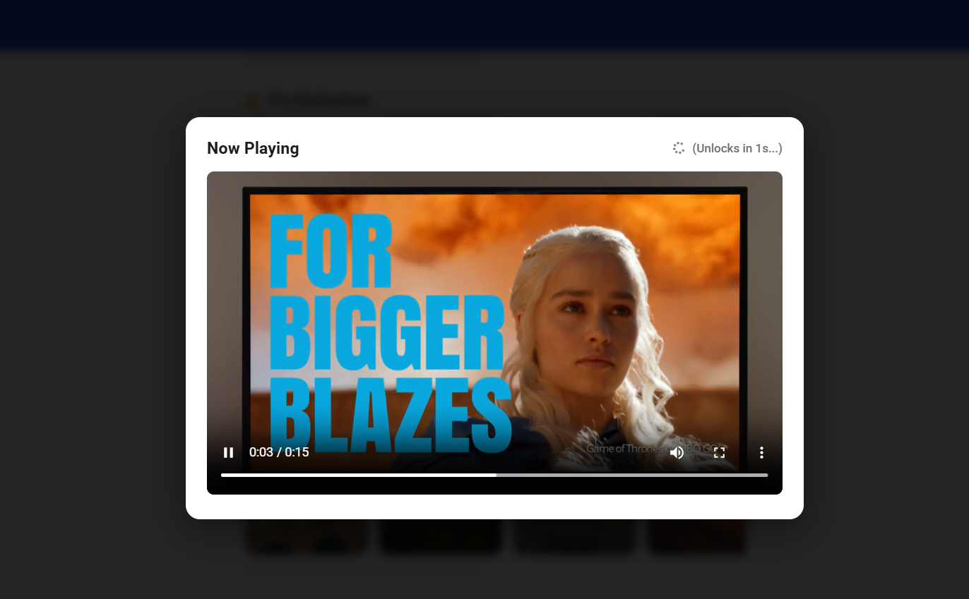
IMPLEMENTATION SCREENSHOTS
1
2
3
4
5
6
7
8(A)
9

Slide 12
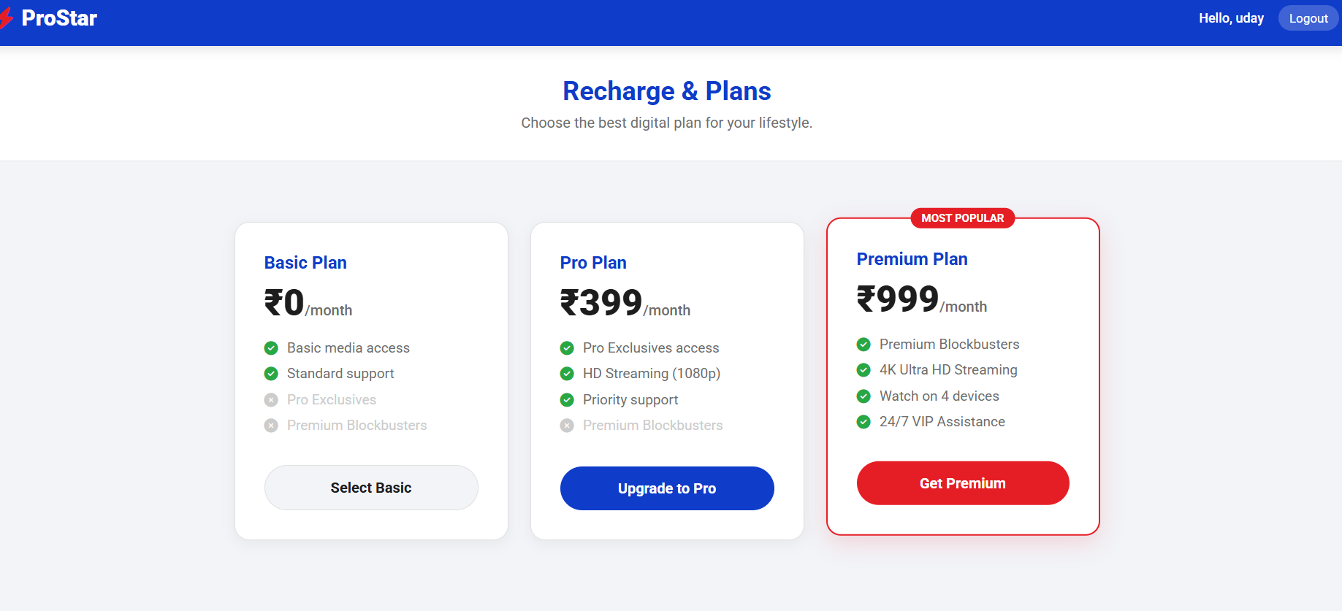
IMPLEMENTATION SCREENSHOTS
1
2
3
4
5
6
7
8(B)
9

Slide 13
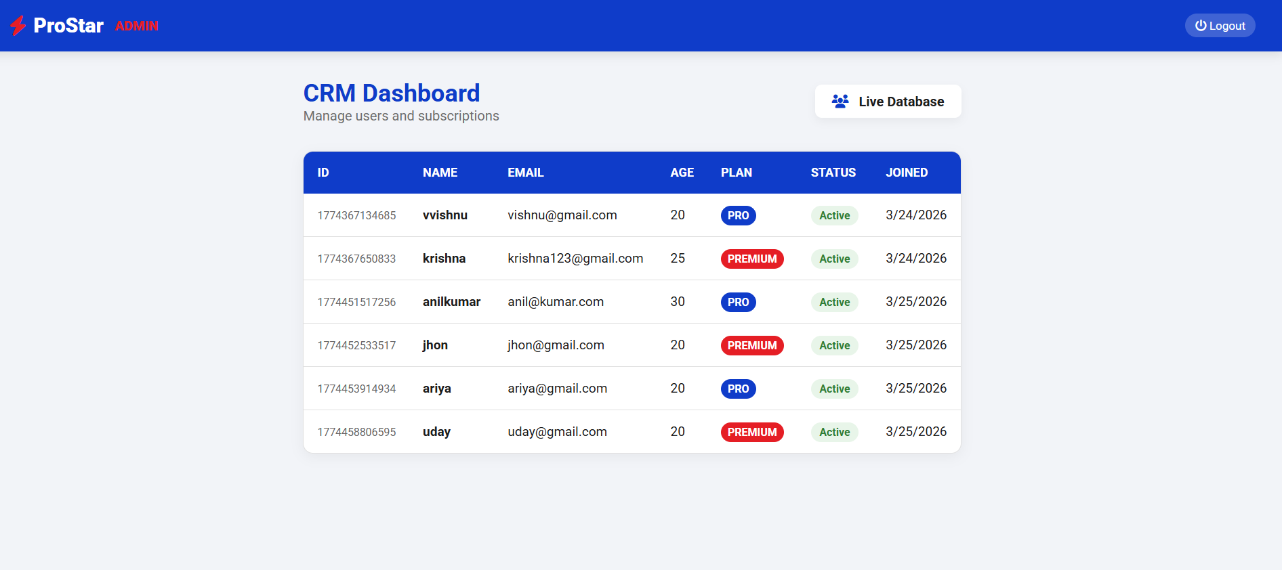
IMPLEMENTATION SCREENSHOTS
1
2
3
4
5
6
7
8(C)
9

Slide 14
ADVANTAGES & LIMITATIONS
Advantages
• Automated membership management • Easy subscription plan handling • Improved data accuracy • User-friendly interface • Time-saving system
Limitations
• Requires internet connection • Initial setup required • Limited features without payment gateway integration
1
2
3
4
5
6
7
8
9

Slide 15
Thank you

